Slide 1

Department: COMPUTER SCIENCE AND ENGINEERING
Trimester: Fall 2022
Course Title: It Organization and Management
Course Code: CSE-413
A Sport Event System
By
The student of 14th, 15th, 16th & 17th batch
Department of Computer Science and Engineering
To
Dr. Kingkar Prosad Ghosh
Course Teacher
Head of the Department
NARAYANGANJ 2023

Slide 2
A Sports Event System

Slide 3
INDEX
Introduction.
Programming language/platform & Database of the project.
Attributes & Function of the project.
Architecture of the project(Activity diagram, Use-Case Diagram, ER Diagram).
Main Feature(4 main feature) of the project.
Output/Screenshot of the project.
Advantage & Disadvantage of the project.
Team Role of the project.
Conclusion.

Slide 4
Introduction of the project

Slide 5
Introduction
Our project is about A Sports Event Management System(SMS) which is objective to provide which manages the activity of many sports at a time. This Sports Event Management System is a database website which is developing according to the sports management situation.
We have three sections in our project which are Admin, Teacher & Student.
Admin Panel
In our project Admin can manage all the sections and can control the whole project. Here we are using Django in our project and Django provides a built-in admin module which can be used to perform CRUD operations on the models.

Slide 6
Student Panel
A student can view and choose any of the 15 game and know about them. Three main functionalities in dashboard for the students like Game Schedule, Score Board, Final Result & Future Event. From game schedule, student can get to know about date and time of all the upcoming games. From score board, a student can gather all kind of information about players, teams and game scores. From final result & future event, a student can view the final result of all team and upcoming events.

Slide 7
Teacher Panel
A teacher can manage and organize all the players and games . Four main functionalities in dashboard for the teachers like Arrange team, Make Schedule, Score Board, Final Result & Future Event. From arrange team, A teacher can add new players and teams and manage their details. From Make Schedule, teachers can make schedule for the upcoming games and inform all the players via e-mail about game schedules and other information. From score board, a teacher can publish all the information about players and also publish game scores. From final result & Future event, a teacher can publish the result of all 15 games and upcoming events.

Slide 8
Programming Language/Platform of the Project

Slide 9














Programming language(s)/platform
Software Requirements: Programming languages/platform that we used for the front-end:
Visual Studio Code Hypertext Markup Language (HTML)
Xampp Server
Cascading Style Sheets (CSS)
Hardware Requirements:
Front-end CSS framework (BootStrap)
Computer System
JavaScript
Language used for the back-end are :
Python
Web-framework (Django)
Backend Database (SQLite)

Slide 10
Attributes & Functions of the Project

Slide 11
Attributes & Functions
Arrange Team:
Add Player: Teacher will create teams by adding players according to the specific sports the student wishes to compete in.
Game wise player: Adding all the team information that they are participating in.
Make Schedule:
Sending Mail: Schedule/Reminder of games will be sent to the students through mail.
All Selected players: All selected players of all teams and games who are qualified will be shown sport and team wise.
Game Level: Schedule for preliminary, semifinals and finals will be shown.
11

Slide 12
Attributes & Functions
Scoreboard:
Single Player Information: Single player registration.
All registered Team: All the arranged teams will make final registration here.
All Game Information: All the previous and present results of the tournaments will be available here.
Final Result/Future Arrangements:
Recent result of the game: Updating the results of the scheduled final tournament’s results of that particular day.
Future Event: Upcoming schedules for future events will be updated here.
12

Slide 13
Architecture of the Project

Slide 14
Architecture of the Project
Before designing a system, the architecture is made with different perspectives in mind. The most important part is to visualize the system from the perspective of different viewers. The better we understand the better we can build the system.
So, for designing and implementing we are using three types of UML diagram in our project which are-Activity Diagram, Use-Case diagram and ER diagram.

Slide 15
Activity Diagram
Activity Diagram: Activity diagram is basically a flowchart to represent the flow from one activity to another activity. The activity can be described as an operation of the system. The control flow is drawn from one operation to another. This flow can be sequential, branched, or concurrent.

Slide 16
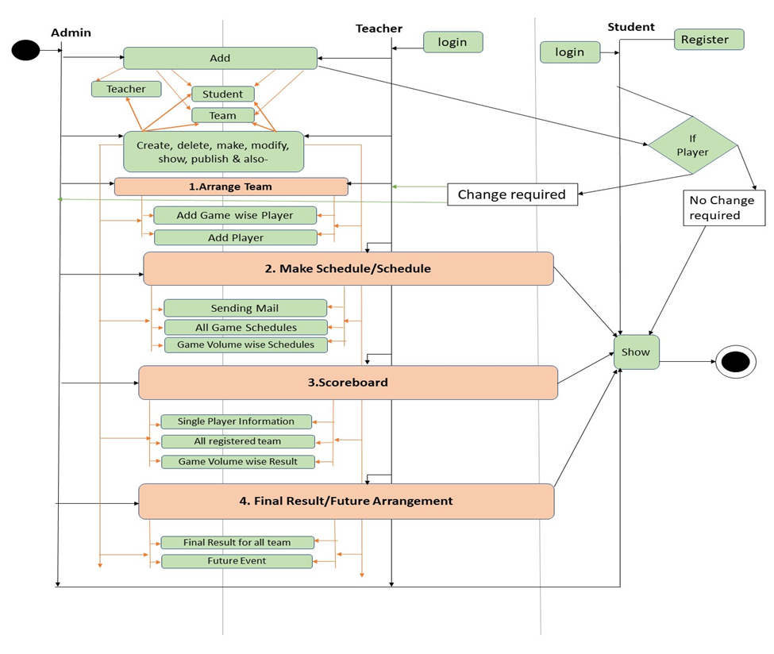
Activity Diagram

Slide 17
Use Case Diagram
What is Use Case Diagram:
A UML use case diagram is the primary form of system/software requirements for a new software program underdeveloped. Use cases specify the expected behavior (what), and not the exact method of making it happen (how).
Purpose of Use Case Diagram:
Use case diagrams are typically developed in the early stage of development and people often apply use case modeling for the following purposes:
Specify the context of a system
Capture the requirements of a system
Validate a systems architecture
Drive implementation and generate test cases
Developed by analysts together with domain experts

Slide 18

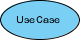
Notation Description:
Subsystems: In UML models, subsystems are a type of stereotyped component that represent independent, behavioral units in a system. Subsystems are used in class, component, and use-case diagrams to represent large-scale components in the system that you are modeling.
Actors: An actor represents a role of a user that interacts with the system that you are modeling. The user can be a human user, an organization, a machine, or another external system.
Use cases: A use case describes a function that a system performs to achieve the user’s goal. A use case must yield an observable result that is of value to the user of the system.

Slide 19
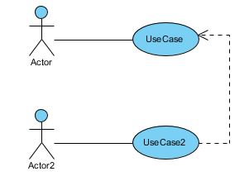
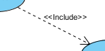
Relationships in use-case diagrams: In UML, a relationship is a connection between model elements. A UML relationship is a type of model element that adds semantics to a model by defining the structure and behavior between the model elements.
Include: An include relationship specifies how the behavior for the inclusion use case is inserted into the behavior defined for the base use case.

Slide 20
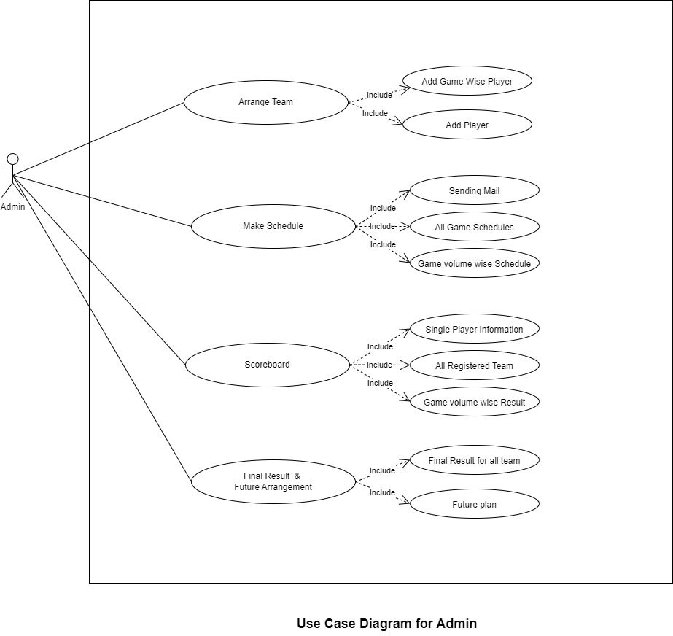
Use Case Diagram for Admin:

Slide 21
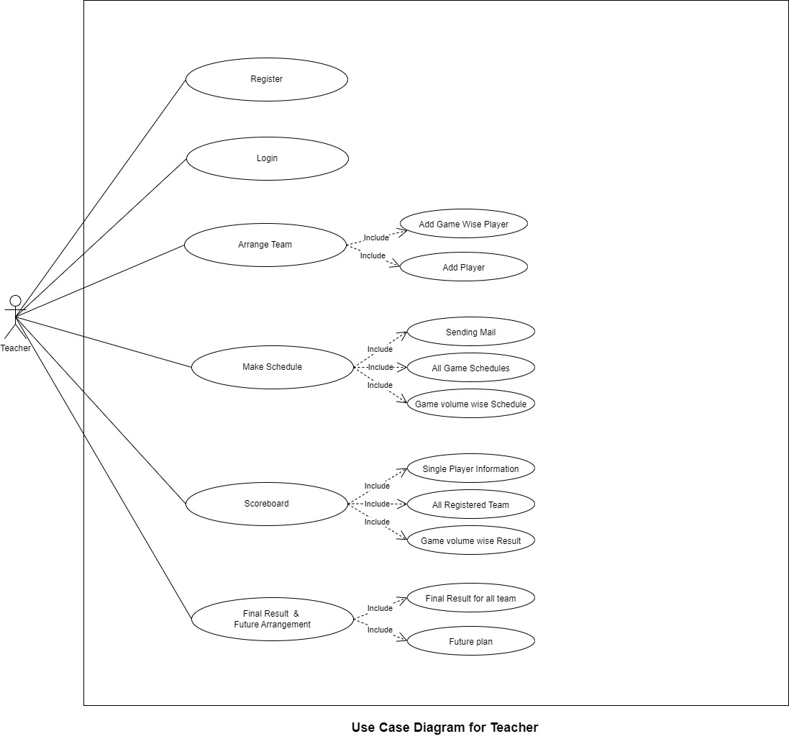
Use Case Diagram for Teacher:

Slide 22
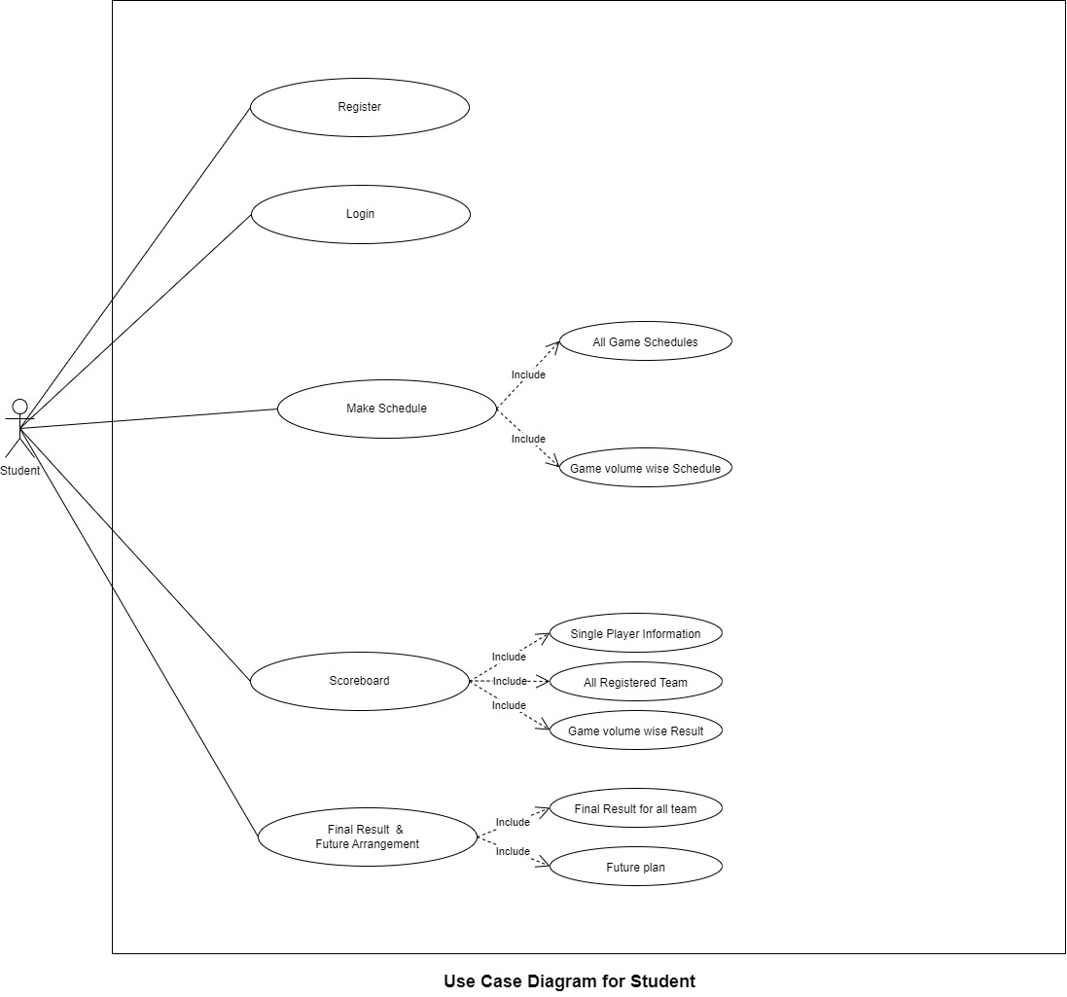
Use Case Diagram for Student:

Slide 23
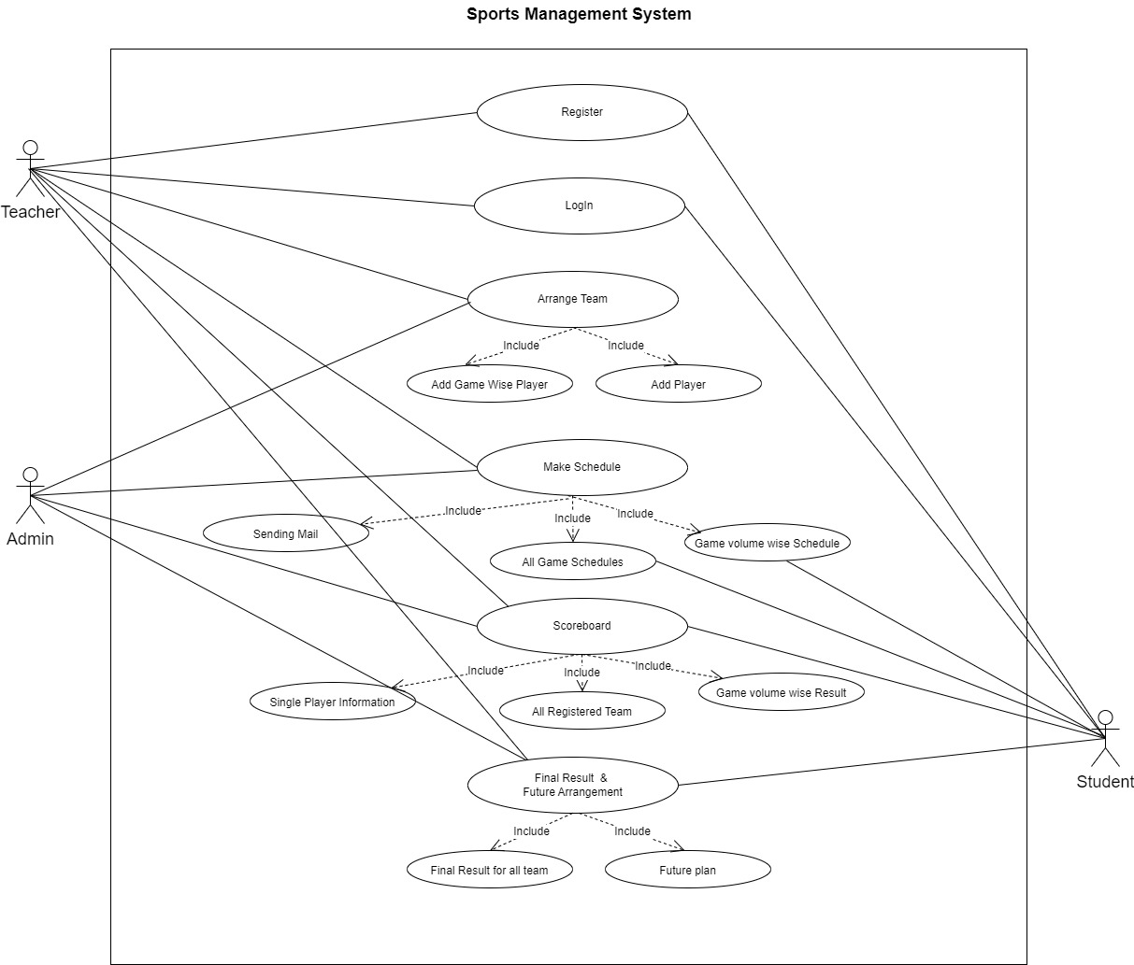
Use Case Diagram for Sports Management System:

Slide 24
ER Diagram
ER Diagram stands for Entity Relationship Diagram, also known as ERD is a diagram that displays the relationship of entity sets stored in a database. In other words, ER diagrams help to explain the logical structure of databases. ER diagrams are created based on three basic concepts: entities, attributes and relationships.

Slide 25
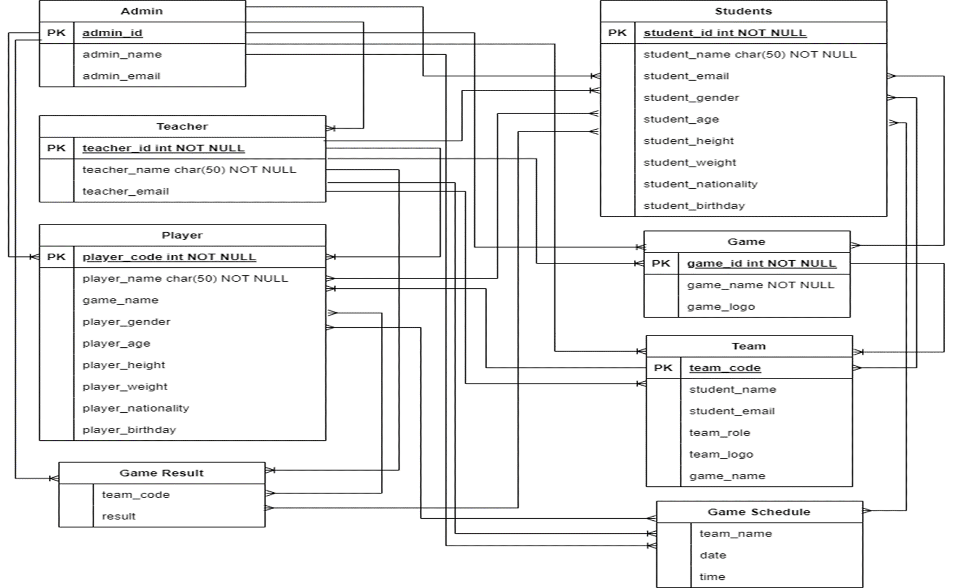
ER Diagram for Sports Management System:

Slide 26
Four Main Features of the project

Slide 27
Main Features
i) Arrange Team
In this feature, A teacher will be able to add new players for creating a team and manage all the data about those players. So, it can visualize which & how many game is playing by a player.
ii) Make Schedule
In this feature, a fixture will be generate for each game where preliminary, semifinal, final schedule & timing will be mentioned. And according to the game, player will be notified by an email as a reminder right before his/her match. We can also view selected team & player for each game level in this section.

Slide 28
Main Features(con.)
iii) Scoreboard
In this feature, all present and previous score of the tournament will be saved. Single player registration & Team registration will be done in this section.
iv) Final Result/Future Arrangements
In this feature, a teacher will publish recent game result when the match is finished. And the upcoming event page will be updated.

Slide 29
Output of the project

Slide 30
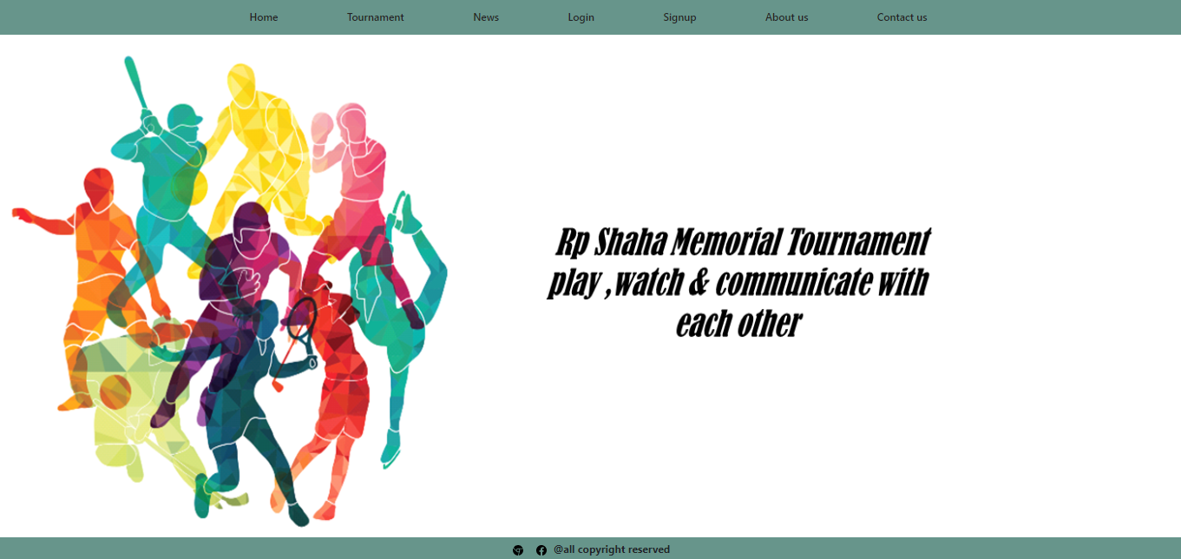
Output
Home page

Slide 31

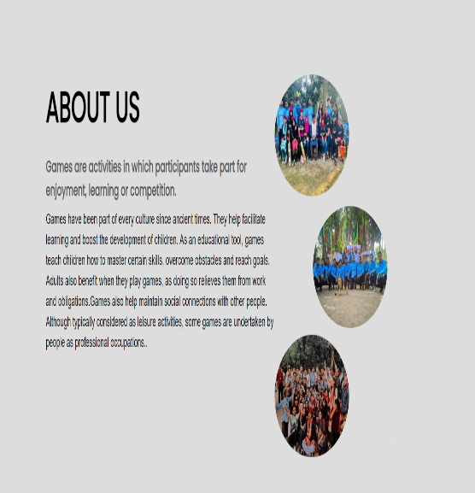
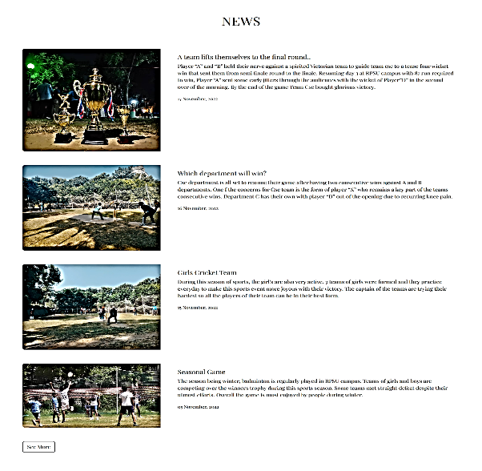
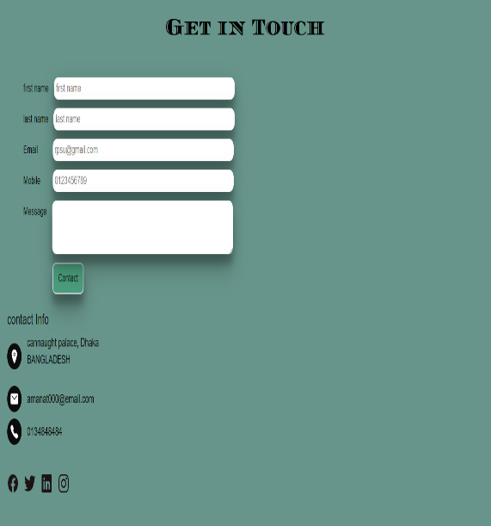
Output
Tournament
About
News
Contact

Slide 32
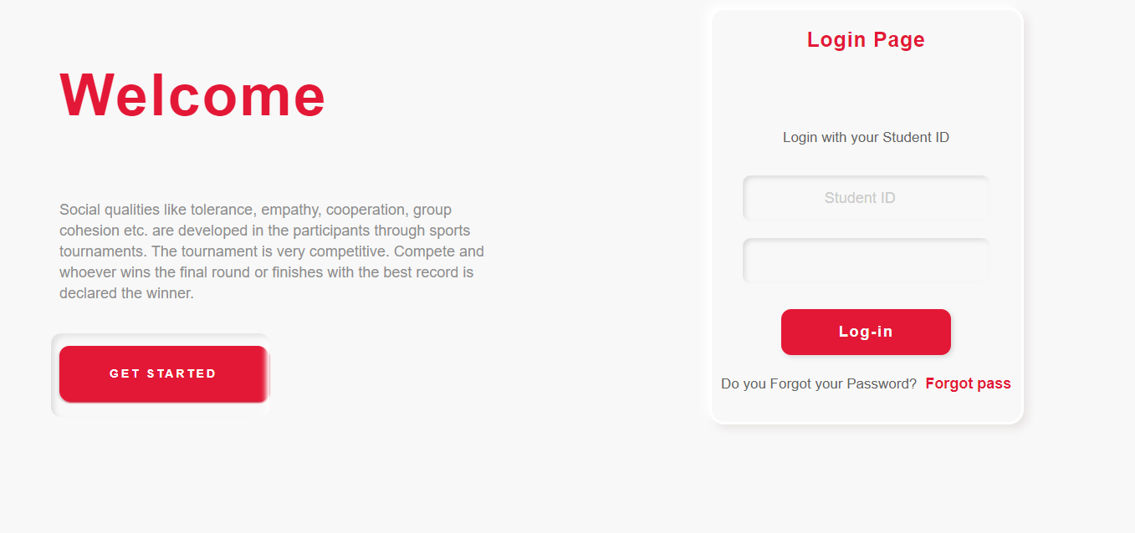
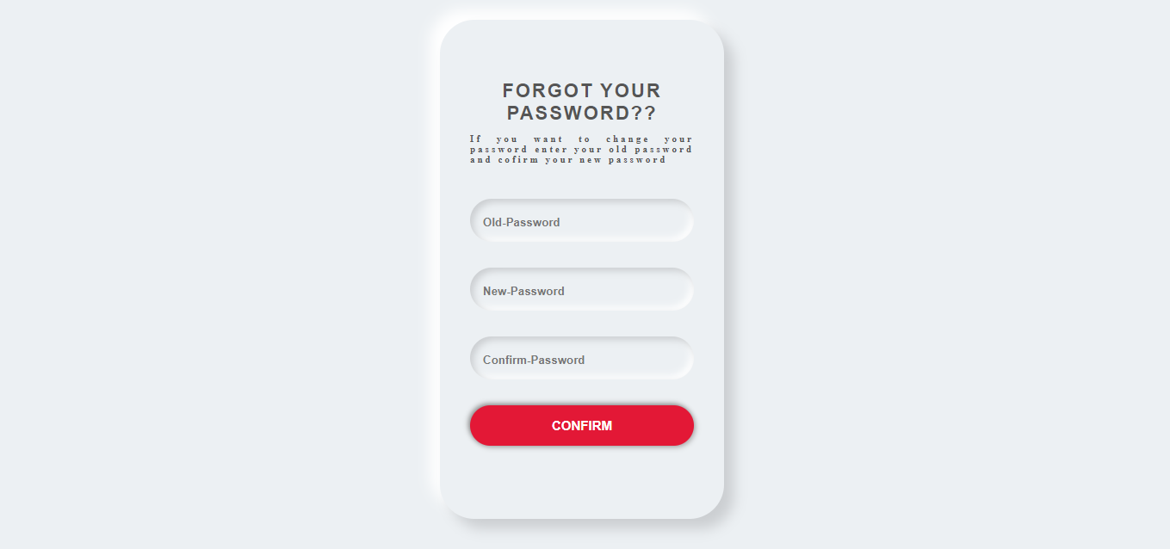
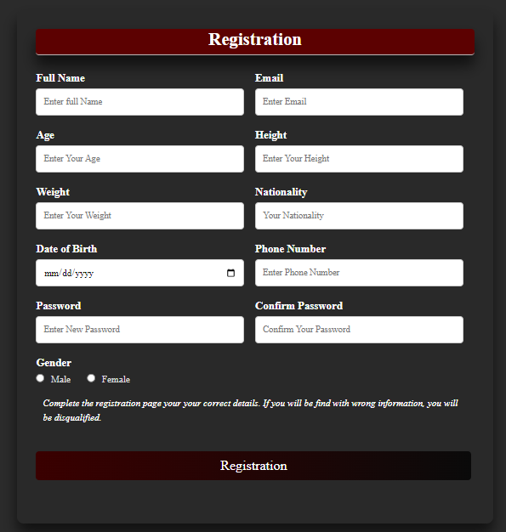
Output
Registration
Login
Forget Password

Slide 33
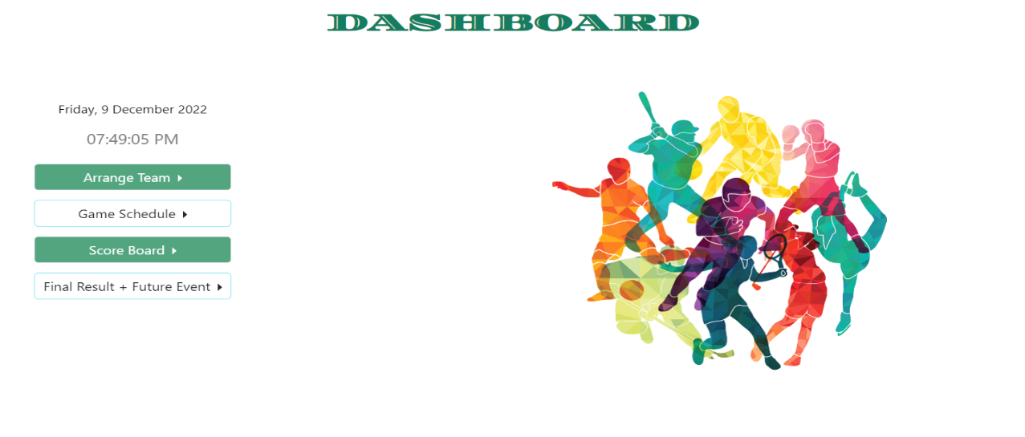
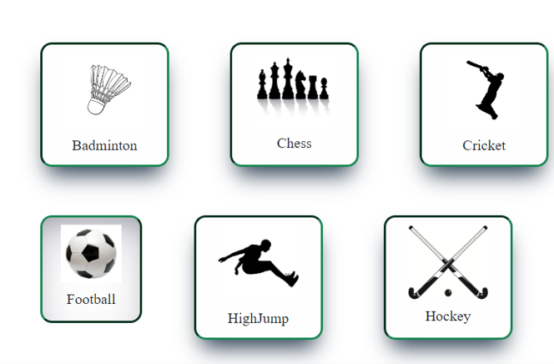
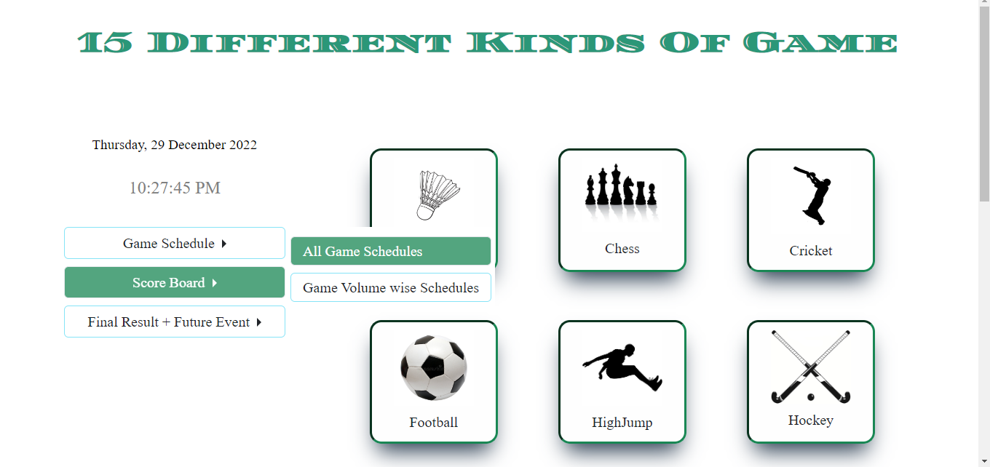
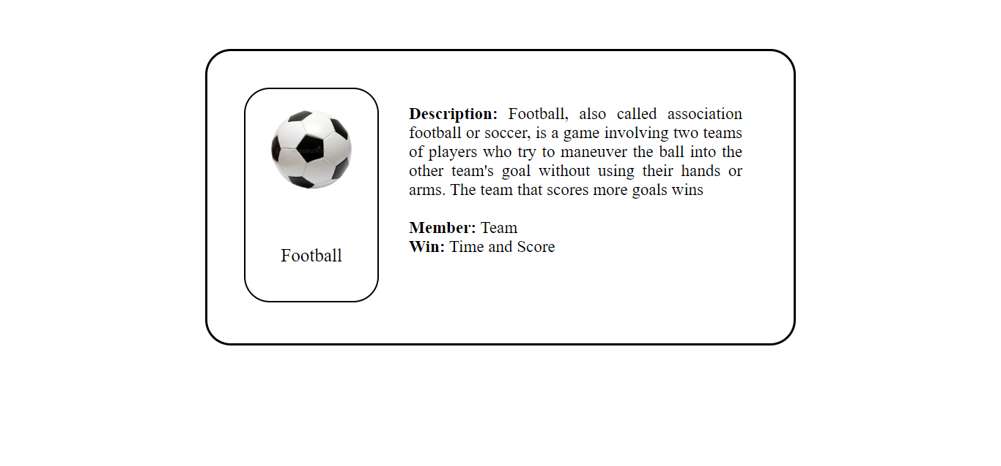
Output
Admin Dashboard
Game Description
Student Dashboard

Slide 34
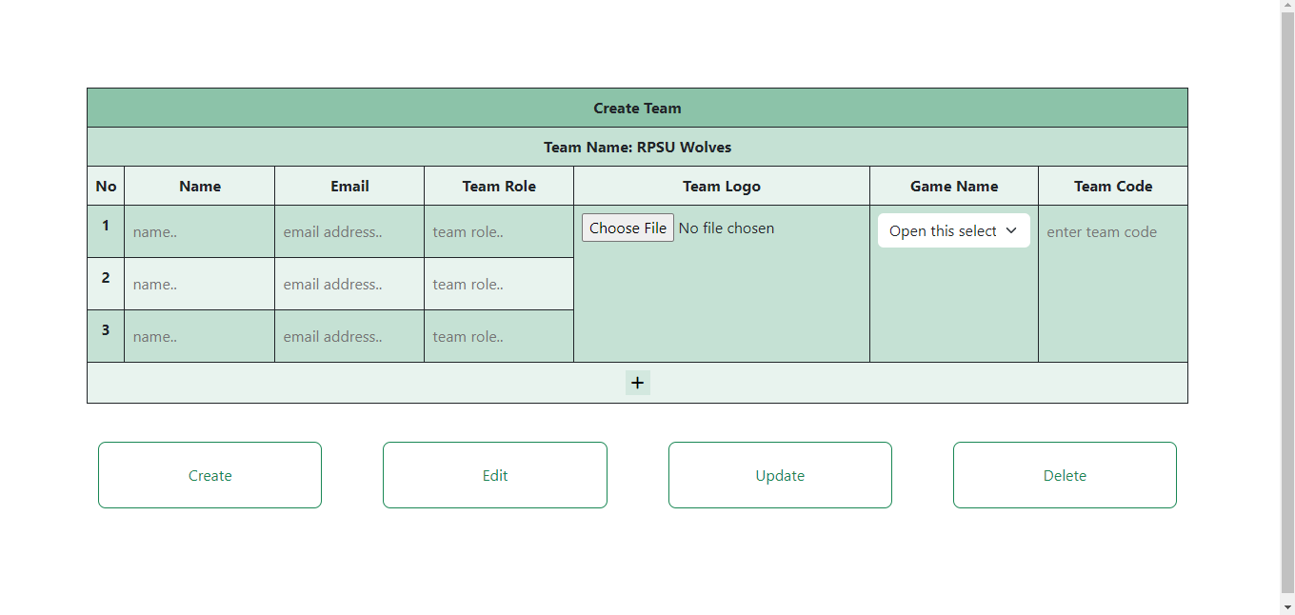
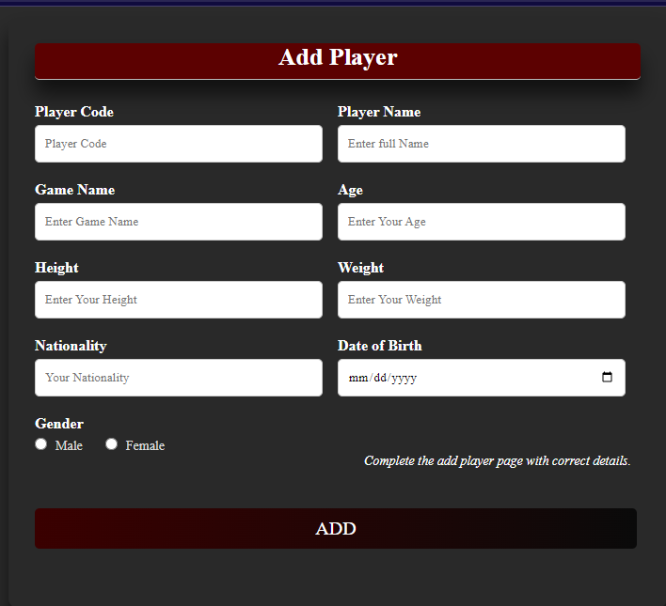
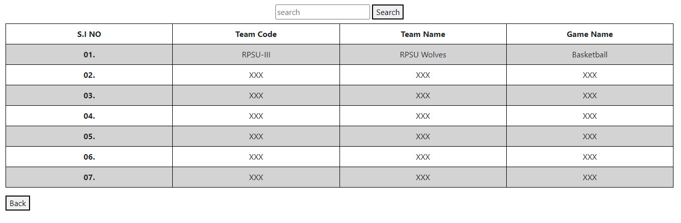
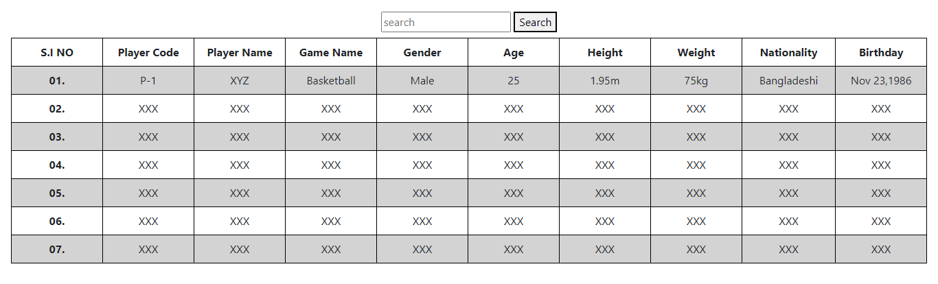
Output
Create Team by Teacher Panel
Add Player by Teacher Panel
Team Information
Student Information

Slide 35
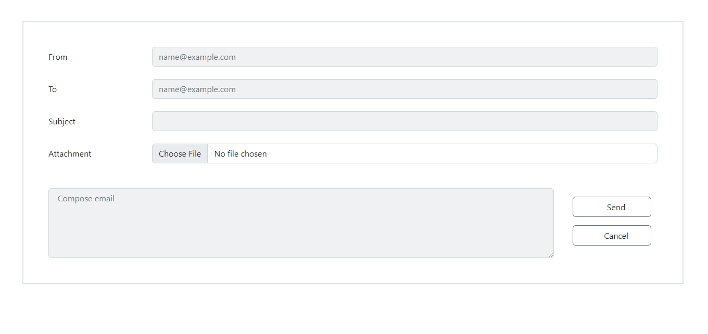
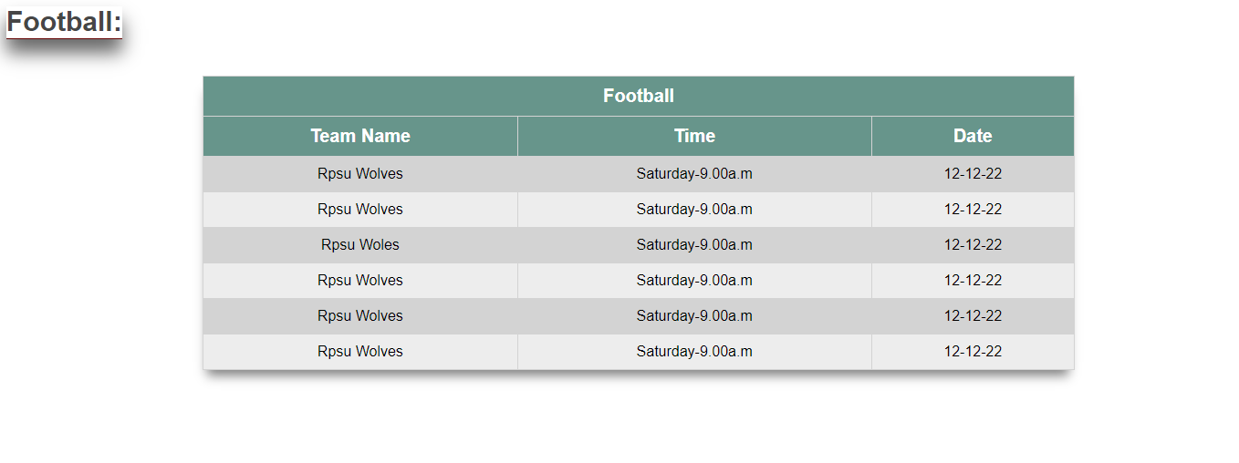
Output
All Game Schedule Together
Mailing System by Teacher Panel

Slide 36
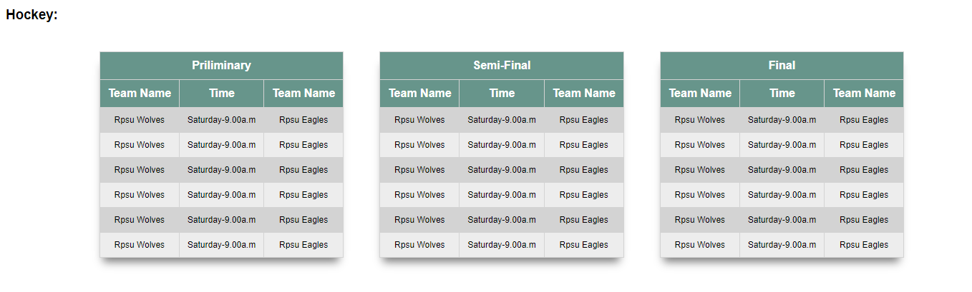
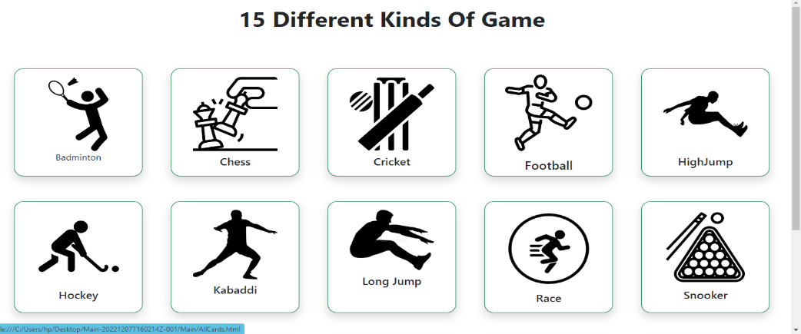
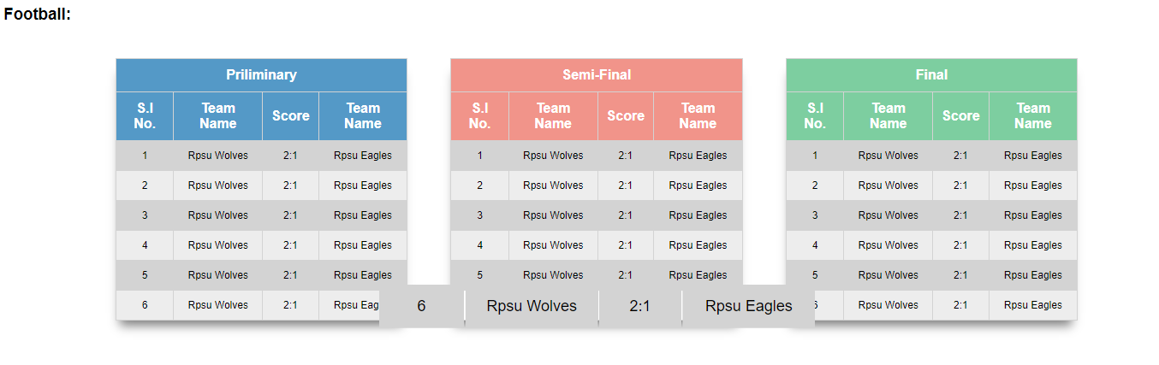
Output
Game Volume Wise Schedule
Game Volume Wise Result

Slide 37
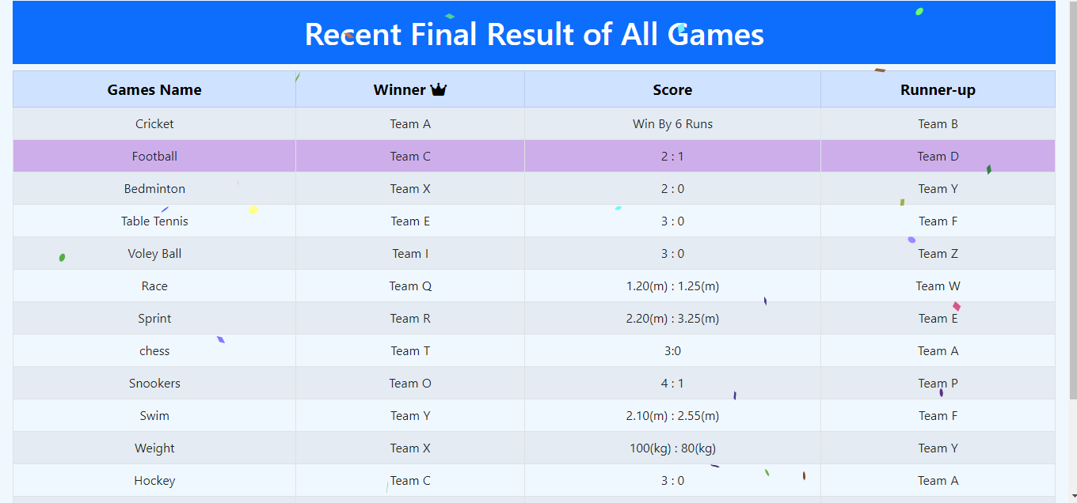
Output
Future Event
Final Result for All team/Winner team Result

Slide 38
Advantage & Disadvantage of the project

Slide 39
Advantages & Disadvantages
Advantages
Online registration and payments for players.
Easy and effective player communication through automatic alerts, emails, and newsletters.
Giving you a new, clean, mobile website that attracts customers and is easier to find on Google.
A complete database of contacts that’s very easy to search, filter, and update.
Sports management system is the amount of work assigned to you and schedule tends to be more inconsistent.
It helps in improving the collaboration among team members.
Disadvantages
Typically work alone and do not have much face-to-face interaction with other team members.
It is difficult for many individuals to use complex technological systems.
This line of work can be stressful for both you and others.
It is sitting at a desk for the majority of the day starting at your computer. Some may enjoy this, but others may struggle with sitting for the majority of your day without much physical activity.
Time consuming.

Slide 40
Team Role of the project

Slide 41


Team Role
Team roles represent a tendency to interact with others in a specific way to make the progress of the team easier. This approach enables an individual or team to benefit from self-knowledge and adjust behavior according to the demands being made by the external situation.
41

Slide 42
Role of Team Members
Frontend team members who are beginners among them have learned and completed the simple tasks and those who are good at it have done well. Some have done backend, leading, document together, some have done frontend, leading, document, presentation work together. In fact, the team members worked as best they could .

Slide 43
Role of Team Members
Group A | Group B | Group C | Group D
Asif (17) (Backend )(Leading ) (Document) | Hasnain(14) (Backend) (Leading ) | Shatabdi(14) (Backend) (Leading) (Document) | Arafath(17) (Leading) (Fullstack)
Tahsin(17) (Fullstack) (Leading) | Arabi(15) (Document) | Sakib(14) (Backend) | Arafat(17) (Frontend)
Shanta(15) (Frontend) (Document) | Ahin(16) (Frontend) | Nabila(15) (Frontend) | Tashfiq(17) (Frontend)
Maria(14) (Frontend) (Document) | Ratry(17) (Frontend) (Document) | Mushfic(17) (Frontend) | Keya(17) (Frontend)
Ahad(14) (Frontend) | Sinja(17) (Frontend) | Nafisha(17) (Frontend) | Tanjim(16) (Frontend) (Document)

Slide 44
Role of Team Members
Group A | Group B | Group C | Group D
Sharmin(15) (Frontend) (Document) | Rafel(17) (Frontend) (Leading) Hasnain(14) (Leading ) | Mehjabin(17) (Frontend) | Mithi(15) (Leading)(Frontend) (Document)
Sudip (17) (Frontend) | Shakil(17) (Frontend) | Ananta(17) (Frontend) | Tony(17) (Frontend)
Amanat(17) (Frontend) |  | Rifa(17) (Frontend) | Hasan(15) (Frontend) (Document)
 |  | Rakib(17) (Frontend) | Tama(15) (Frontend) (Document)

Slide 45
Conclusion of the project

Slide 46
Conclusion
We see by implementing this system, this is a great way to find even more information in one place. It helps students to checks the schedules for their games as well as the ongoing games on campus. Students can see their team members information's as well as scores of all games. This system makes organizing sports events much more efficient and enjoyable. This system makes all the information's of the students and teachers, secure of any external threat. By using our system, we hope that the user would not only enjoy this system, but also get satisfaction from finding how each and every feature of sports management is implemented.

Slide 47
Thank You
47

